Slide 1

Data Analytics and Visualization
(24DSB3101)
An Explainable and Time-Aware Comparative Framework for Retail Sales Forecasting Using Machine Learning Regression Models
Under the Esteemed guidance of
Dr K. Swapnika
Assistant Professor
Department Of Computer Science and Engineering
Submitted by: Batch 19
Team Members:
2420080038 – B. Vyshnavi

Slide 2
Contents
Introduction / Abstract
Problem Statement
Project Objectives
Literature Survey
Project flow diagram
Research Gap Identification
Novelty
Innovation
Feasibility & Project Plan

Slide 3
Introduction
Retail sales forecasting is important for inventory management, demand planning, and business decision-making.
This project develops a machine-learning framework to forecast retail sales using historical sales and related factors such as promotions, holidays, prices, and seasonal patterns.
Multiple regression models including Linear Regression, Decision Tree, Random Forest, XGBoost, and CatBoost will be compared using MAE, RMSE, MAPE, and R².
Time-aware validation and SHAP explainability will be incorporated to improve reliability and understand the factors influencing predictions.

Slide 4
Problem Statement
Accurate retail sales forecasting is challenging because sales are affected by seasonal patterns, promotions, holidays, pricing, and other external factors.
Existing studies often focus on individual datasets or models and primarily compare prediction accuracy.
Therefore, there is a need for a time-aware, explainable and cross-dataset framework that can identify a robust regression model for different retail sales environments.

Slide 5
Objectives
To analyze retail sales data using EDA, correlation analysis, outlier detection, and feature engineering to identify important sales-related factors.
To develop and compare regression models including Linear Regression, Decision Tree, Random Forest, XGBoost, and CatBoost for sales forecasting.
To improve model reliability using hyperparameter tuning and time-aware validation to prevent data leakage.
To identify the most robust and explainable model using MAE, RMSE, MAPE, R², computational time, cross-dataset validation, and SHAP analysis.

Slide 6
Literature Survey
No. | Year | Research Paper / Study | Technique / Framework | Key Contribution | Research Gap
1 | 2026 | Machine Learning Applied to Sales Prediction Modeling: A Systematic Literature Review | ML + Ensemble Models | Reviews ML approaches for sales prediction | Cross-dataset robustness can be further explored
2 | 2026 | Machine Learning for Sales Forecasting in Industrial Environments | ML + Regression | Reviews forecasting models and input factors | Explainability and integrated comparison remain limited
3 | 2025 | Autoregressive Multimodal Transformer for Sales Forecasting | Transformer + Exogenous Data | Uses external information for sales forecasting | Complex architecture and high computational requirements
4 | 2025 | ML Demand Prediction Under Macroeconomic Volatility | ML + External Variables | Studies demand prediction under economic changes | Retail-specific cross-dataset comparison can be improved
5 | 2025 | Smart Retail Using Machine Learning for Demand Forecasting | ML + Inventory Optimization | Connects forecasting with inventory decisions | Explainable model selection remains an opportunity

Slide 7
Literature Survey
No. | Year | Research Paper / Study | Technique / Framework | Key Contribution | Research Gap
6 | 2025 | Sales Forecasting Using Time Series and Regression Techniques | Regression + Time Series + CatBoost | Compares regression-based forecasting approaches | Broader cross-dataset validation can be explored
7 | 2025 | Deep Learning for New Fashion Product Demand Prediction | Deep Learning + Demand Correction | Handles demand prediction for new products | Requires complex deep-learning architecture
8 | 2024 | Demand Forecasting Using Ensemble Learning with Feature Engineering | Ensemble Learning + Feature Engineering | Improves forecasting using engineered features | Explainability and robustness across datasets can be extended
9 | 2025 | Spatio-Temporal Predictive Modeling Techniques: A Survey | Spatio-Temporal ML | Highlights importance of temporal information | Retail-specific time-aware framework can be developed
10 | 2024 | Walmart Sales Forecasting Using XGBoost and Feature Engineering | XGBoost + Feature Engineering | Demonstrates ML-based retail sales forecasting | Limited comparison across multiple retail datasets

Slide 8
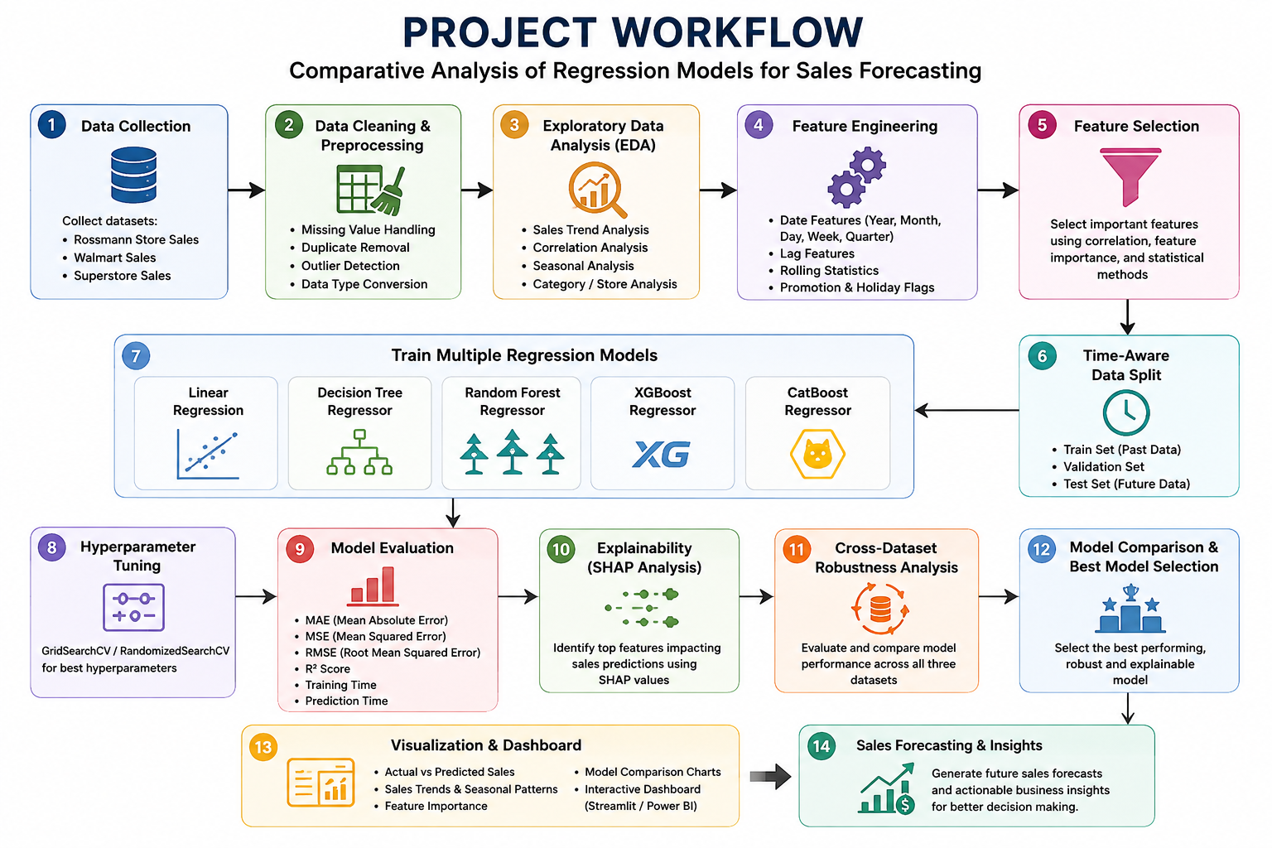
Project Workflow

Slide 9
Research Gap
The literature indicates the following gaps:
Limited cross-dataset evaluation: Many studies focus on one dataset or business environment.
Accuracy-focused evaluation: Models are often selected primarily based on forecasting accuracy.
Limited explainability: The reasons behind model predictions are not always clearly presented.
Insufficient time-aware validation: Random train-test splitting can cause data leakage in forecasting problems.
Limited robustness analysis: A model performing well on one dataset may not perform consistently on another.

Slide 10
Novelty
Cross-Dataset Explainable Model Robustness Framework
The project will combine:
Time-Aware Validation + Multiple Regression Models + Hyperparameter Tuning + SHAP Explainability + Cross-Dataset Evaluation
Instead of selecting a model only because it has the highest R², the project will evaluate accuracy, stability, computational efficiency, and interpretability to identify the most reliable model.

Slide 11
Innovation
Machine Learning Prediction
↓
Sales Forecast
↓
Model Comparison
↓
Performance Metrics
↓
SHAP Explanation
↓
Cross-Dataset Validation
↓
Model Robustness Score
↓
Best Model
↓
Business Insights

Slide 12
Feasibility
Technical Feasibility: Can be implemented using: Python , Pandas , NumPy ,
Scikit-learn , XGBoost , CatBoost ,SHAP ,Plotly
Dataset Feasibility: Public retail datasets such as Rossmann, Walmart, and Superstore can be used.
Computational Feasibility: The proposed regression and ensemble models can be trained using Google Collab or normal academic computing systems without requiring expensive deep-learning infrastructure.
Implementation Feasibility: Open-source tools support the complete pipeline including:
Data preprocessing → EDA → ML prediction → Explainability → Model comparison → Dashboard

Slide 13
Project Plan
Phase 1: Literature Survey & Research Gap Identification
↓
Phase 2: Dataset Collection & Preprocessing
↓
Phase 3: Feature Engineering & Feature Selection
↓
Phase 4: Exploratory Data Analysis , Time-Aware Train/Test Splitting
↓
Phase 5: Baseline Model Training
↓
Phase 6 : Regression Model Development, Hyperparameter Tuning
↓
Phase 7: Model Evaluation & Comparative Analysis
↓
Phase 8: SHAP-Based Explainable AI
↓
Phase 9: Cross-Dataset Robustness Analysis
↓
Phase 10: Interactive Dashboard Development
↓
Phase 11: Testing & Performance Validation
↓
Phase 12: Documentation & Final Presentation

Slide 14
THANK YOU
THANK YOU

